Slide 1
Info Edge (India) Limited
India’s Premier Classified Internet Company

Slide 2
Disclaimer
By attending the meeting/telephonic call where this presentation is made, you agree to be bound by the trailing restrictions regarding the information disclosed in this presentation. This presentation has been prepared by Info Edge (India) Limited (the “Company”) solely for information purposes without any regard to any specific objectives, financial situations or information needs of any particular person and does not constitute a recommendation regarding the securities of the Company.
This presentation, its contents and any oral information provided in connection with this presentation are strictly confidential and should not be copied, published or reproduced in any form or distributed, disseminated or disclosed, in whole or part, by recipients directly or indirectly to any other person. Failure to comply with this restriction may constitute a violation of applicable securities laws.
This presentation contains certain statements that are or may be forward-looking statements. These statements include descriptions regarding the intent, belief or current expectations of the Company or its directors and officers with respect to the results of operations and financial condition of the Company. These statements can be recognized by the use of words such as “expects,” “plans,” “will,” “estimates,” “projects,” or other words of similar meaning. Such forward-looking statements are not guarantees of future performance and involve risks and uncertainties, and actual results may differ from those in such forward-looking statements as a result of various factors and assumptions which the Company believes to be reasonable in light of its operating experience in recent years. The risks and uncertainties relating to these statements include, but not limited to, risks and uncertainties, regarding fluctuations in earnings, our ability to manage growth and competition, among others. The Company does not undertake any obligation to revise or update any forward-looking statement that may be made from time to time by or on behalf of the Company. Any investment in securities issued by the Company will also involve certain risks. There may be additional material risks that are currently not considered to be material or of which the Company, its promoters, any placement agent, their respective advisers or representatives are unaware. Against the background of these risks, uncertainties and other factors, viewers of this presentation are cautioned not to place undue reliance on these forward-looking statements. The Company, its promoters, any placement agent, their respective advisers or representatives assume no responsibility to update forward-looking statements or to adapt them to future events or developments. Accordingly, any reliance you place on such forward-looking statements will be at your sole risk.
The information contained in this presentation has not been independently verified. The information in this presentation is in summary form and does not purport to be complete. No representation, warranty, guarantee or undertaking, express or implied, is or will be made as to, and no reliance should be placed on, the accuracy, completeness, correctness or fairness of the information, estimates, projections and opinions contained in this presentation. Potential investors must make their own assessment of the relevance, accuracy and adequacy of the information contained in this presentation and must make such independent investigation as they may consider necessary or appropriate for such purpose. Such information and opinions are in all events not current after the date of this presentation. Further, past performance of the Company is not necessarily indicative of its future results. Any opinions expressed in this presentation or the contents of this presentation are subject to change without notice. This presentation should not be construed as legal, tax, investment or other advice. Neither the Company or its promoters, nor any placement agent or their respective advisers or representatives shall have any responsibility or liability whatsoever (for negligence or otherwise) for any loss howsoever arising from this presentation or its contents or otherwise arising in connection therewith. The information set out herein may be subject to updating, completion, revision, verification and amendment and such information may change materially. Neither the Company, its promoters, any placement agent, nor any of their respective advisers or representatives is under any obligation to update or keep current the information contained herein.
This presentation does not constitute or form part of and should not be construed as, directly or indirectly, any advertisement, offer or invitation or inducement to sell or issue, or any solicitation of any offer to purchase or subscribe for, any securities of the Company by any person whether by way of private placement or to the public, in any jurisdiction, including in India, the United States, Australia, Canada or Japan, nor shall it or any part of it or the fact of its distribution form the basis of, or be relied on in connection with, any investment decision or any contract or commitment therefor. Investing in securities involves certain risks and potential investors should note that the value of the securities may go down or up. Accordingly, potential investors should obtain and must conduct their own investigation and analysis of the relevant information carefully before investing.
Securities of the Company may not be offered or sold in the United States , except pursuant to an applicable exemption from, or in a transaction not subject to, the registration requirements under the United States Securities Act of 1933, as amended (the “Securities Act”). By reviewing this presentation, you are deemed to have represented and agreed that you and any person you represent are not a U.S. person (as defined in Regulation S under the Securities Act) and are outside of the United States and not acting for the account or benefit of a U.S. person.
This presentation is not a prospectus, a statement in lieu of a prospectus, an offering circular, an advertisement or an offer document under the Companies Act, 2013, the Securities and Exchange Board of India (Issue of Capital and Disclosure Requirements) Regulations, 2018, each as amended, or any other applicable law in India.
This presentation contains the Company’s unaudited financial and non financial information. Investors should be aware that such information may be subject to certain adjustments during the course of audit/review and the audited/reviewed financial statements of the Company, when announced, may differ from those contained in this presentation

Slide 3













Info Edge Businesses
Core Operating Businesses.
Acquisitions and Strategic Investments
Financial Investments

Slide 4
History
Naukri.com was launched in 1997. Funded by ICICI Ventures in 2000
Operating Business profitable since 2002
Expanded to other India-focused classified verticals -99acres, Shiksha and Jeevansathi (2004-2008)
Public listing in 2006
First Phase of financial investment (including Zomato and Policy Bazaar) from 2007-2012.
2 successful QIPs in 2014 and 2020.
Listing of Zomato & Policybazar in FY’22

Slide 5
InfoEdge – Key strengths
Naukri.com- market leader in recruitment classified business and cash engine for the company
Core verticals are in the areas of significant life decisions – Education Search and Counselling, Job Search, House Search and Matrimony. It represents India-specific, diverse and large user base markets
Local understanding of cultural nuances, consumers and the business environment is a formidable advantage as a domestic company and an edge over multinational tech companies
A vast network of branch sales to service our customers better.

Slide 6
Info Edge – Key strengths
The availability of Indian Tech talent coupled with voluminous data and traffic on the platforms allows us to leverage ML models to improve user experience
Negative working capital, “~zero Debt”, India-centric topline, and a payroll-heavy cost structure hedged due to Naukri. A large pool of cash and liquid investments are a few risk-mitigating factors
Scores high on Governance, Ethics, Reputation ,Transparency and Professional Management helping attract and retain talent.

Slide 7
Operating Business Org Chart
Hitesh Oberoi
Cofounder, CEO and MD.
Pawan Goyal
Chief Business Officer- Naukri
Chintan Thakkar
Director and Chief Financial Officer
Maneesh Upadhyaya
Chief Business Officer- 99acres.
Sharmeen Khalid.
Chief HR Officer.
Rohan Mathur
Business Head- Jeevansathi
Sumeet Singh
Chief Marketing Officer.
Vivek Jain
Chief Business Officer- Shiksha.
Sumit Jaiswal
Corporate Development
Shantanu Mathur
Head- BigShyft
Roushan Bharti
Head- Jobhai.com

Slide 8
Board of Directors
Whole time
Non Executive
Independant
Sanjeev Bikhchandani (59)
Founder and Executive Vice Chairman
BA Econ. St. Stephen’s.
PGDM IIM-A
Previously with GlaxoSmithKline
Kapil Kapoor (58)
Chairman & Non Executive Director
B.A.Econ, PGDM IIM-A
Previously COO (Global Business Development), Timex Group
Arindham Bhattacharya (61)
B Tech (IIT Kharagpur) , M Sc ( Univ Of Warwick, MBA ( IIM-A), PhD Engineering ( Univ of Warwick)
Previously worked with Boston Consulting Group.
Aruna Sundarajan (63)
Diploma in Public Administration, ( International Institute of Public Administration , Italy)
Previously worked with Indian Administrative Services
Hitesh Oberoi (50)
CoPromoter, MD and CEO
B.Tech IIT Delhi, PGDM IIM-B
Previously with HUL (Unilever)
Bala Deshpande (56)
Non Executive Director
MA Econ., MMS JBIMS
Sr. MD, New Enterprise Associates (NEA)
Sharad Malik (59)
Independent Director
B Tech IIT-D, MS, PhD, University of California
Chair-(Deptt. of Electrical Engineering), Princeton University
Ashish Gupta (56)
Independent Director
B Tech IIT-K, Phd from Stanford University
Founder Tavant Technologies, Junglee; Amazon
Chintan Thakkar (56)
Whole-time Director and CFO
Chartered Accountant
Previously with Computer Associates, India
Saurabh Srivastava (76)
B.Tech IIT Kanpur, M.Sc Harvard
Founder IIS Infotech
(Now Xansa)
NASSCOM, TIE, IAN, IVCA
Geeta Mathur (56)
Independent Director, Chairman, Audit Committee
Chartered Accountant
Associated with ICICI Bank, Helpage India, IPE Global.
Pawan Goyal (52) **
BaTech IIT Kanpur, Phd the University of Texas at Austin
Previously worked with Adobe Systems, Microsoft,
Naresh Gupta (56)
B Tech IIT Kanpur, Ph.D, University of Maryland
Previously MD, Adobe India
** Pawans appointment is effective 30th April’23. Shareholders approval received through postal ballot.

Slide 9
Market Cap (Rs Cr)
High Compounding rate of Returns
EPS** (Rs)
52*
50,300
*Rs 13, Extrapolated Q4.
50,000
18% CAGR
36
40,000
29% CAGR
30,000
26
27
22
22
Rs 39, YTD Q3.
20,259
20,000
10,194
10,000
45% CAGR
3,898
27% CAGR
19% CAGR
26% CAGR
874
2006
2010
2014
2018
2022
FY18
FY19
FY20
FY21
FY22
FY23
- Doubling of market cap every 3 years.
- 24% CAGR in market cap in USD.
- Consistent annual dividend payout. Rs 801 Cr (28% of operating PAT) paid out as dividend since IPO
- Total fund raise since inception Rs 2752 Cr
* EPS for FY23 projected basis extrapolation of average EPS for the first 9 months.
** EPS before exceptional items

Slide 10
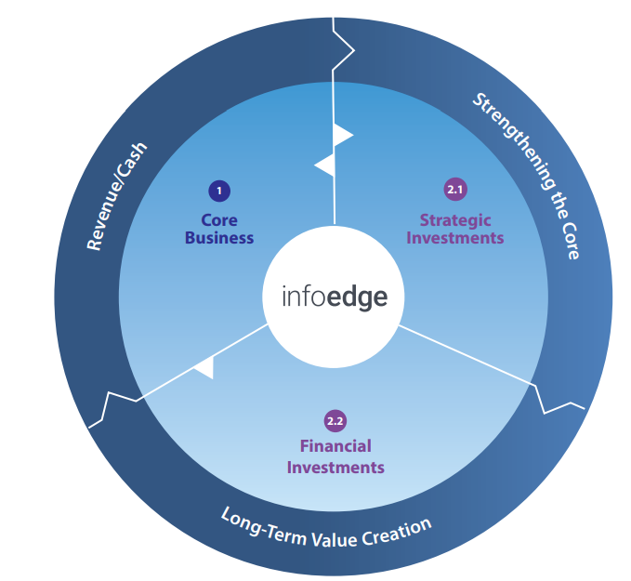
Wheel of Value Creation
Generate Revenue and Cash from core businesses
Strengthening core businesses by M&A/ Strategic investments
Long term value creation by investing surplus funds in financial investments
1
2
3

Slide 11
Cash from the Recruitment business invested in 99acres & Jeevansathi
Recruitment Cash PBT* ~Rs 5,440 Cr
Balance Cash PBT: Rs 4,620Cr
Investment in Jeevansathi Rs 458 cr, 8.4%
Investment in 99acres
Rs 362 cr, 6.6%
Tax shield of 25%-30% on the cash burn of other businesses inside the standalone entity
Approx. 10%-12% of Recruitment profit (post-tax shield) creating other large businesses for future
*Since 2006 till Q3’23.

Slide 12
Cash Flows and Capital Allocation.
Well Defined approach towards Financial Investments
AIF structure for eventual and self-sustained independent financial investment business.
Partnered with reputed Sovereign Fund (Temasek Holdings).
AIF contribution commitment is currently pegged at ~USD 212.5m
Funds created with a term of 12-14 years.
Established Dividend payout track record.
Formal dividend policy of paying 25%-40% of standalone cash PAT .
Track record of consistent dividend payout for last 16 years. Paid 28% of cash PAT as dividend till date.
Strong operating businesses
Strong Operating Cash generation year with a run-rate of 1000 Cr plus ( pre Tax) annually and growing.
Negative working capital due to advance subscription fees ( Rs 835 cr as on 31/12/22)
Asset-light business models
“Zero” Debt.

Slide 14
The largest business with high margin is growing fastest
1073
987
Rs 268 Cr,
Q4 Cash EBITDA extrapolated
18% CAGR
498
470
Rs 805 Cr,
Cash EBITDA YTD Dec’23
371
279
164
2013
2015
2017
2019
2021
2022
2023
Billing ( Rs Cr) & EBITDA (%)
Cash EBITDA ( Rs Cr)
Cashflow for FY23 projected basis extrapolation of average cashflow for the first 9 months

Slide 15
Scale and Growth in Operating Metrics
110k
86k
Unique Customers ( Nos)
Realization per Customer ( Rs ‘000)
93k
80k
CAGR 9.7%
CAGR 4.9%
76k
72k
61k
66k
51k
57k
2014
2016
2018
2020
2022
2014
2016
2018
2020
2022
Registered Job Seekers ( Nos)
82Mn
CV modifications
168.6Mn
69Mn
146.0Mn
CAGR 12%
57Mn
107.1Mn
46Mn
37Mn
64.6Mn
41.4Mn
2014
2016
2018
2020
2022
2014
2016
2018
2020
2022
FY2021 impacted by COVID lockdowns.
**New specifications of CV modification implemented.

Slide 16
What makes Naukri Moat deep and wide.

Slide 17
Recruitment Business- Key Strengths
The virtuous circle of Network effect. The scale of operations
Strong brand and significant online recruitment traffic share of over 70% amongst the conventional job boards in India
The large customer base of over 100k paying customer
A diversified portfolio of products and services enabling talent planning, sourcing, branding and recruitment automation
A vast network of sales and distribution network with over 1000 customer-facing resources.
High margin allows ploughing back of profits in talent, innovation and strengthening of moats for sustainable, efficient and consistent long term growth

Slide 18
Huge customer base catering to domestic and global demand hedges against any economical downturn.
IT & IT
Enabled Services:
% of Revenue: 35.6%.
No Of customer: ~25k
Service Sector:
IT Hardware/ Software,
BPOs, KPOs,
IT Helpdesks
Global Capability Centres ( GCCs).
Non IT Services.
% of Revenue: 37.2%.
No Of Customer:~70k
Service Sector:
Manufacturing
BFSI, Services
Infrastructure, Retail.
Travel and Tourism
Headhunters.
Recruitment Firms.
% of Revenue: 27.2%*.
No of Customer :~18k
Service Sector:
Headhunters.
RPO, Manpower Consultants
*Approx 50% of hiring done by recruitment firms is for IT/ITES companies.

Slide 19
Diversified portfolio of product and services enabling talent planning, sourcing, branding and recruitment automation
Iimjob.com- Market place for MBA & Professionals
Hirist.com- Market Place for Engineers
Jobhai.com- Market place for blue collar jobs
Zwayam- Application Tracking System
Do Select- E Assessment Platform.
Naukri Fast Forward
Ambition Box
Resume Data base
Job Postings
Hiring Campaigns
Branding Services.

Slide 20
Strong sales and distribution network
Geographical Spread as on date
Chandigarh
Nation wide coverage through 69 company branch offices in 55 cities in India
1935 sales/ servicing/ client facing staff.
Delhi NCR (Noida, Gurgaon)
Jaipur
Lucknow
Ahmedabad
Bhopal
Kolkata
Nasik
Indore
Raipur
Mumbai
Aurangabad
Vishakhapatnam
Bhubaneshwar
Hyderabad
Pune
Bangalore
Chennai
Pondicherry
Kochi
Trivandrum

Slide 21
A Strong Leadership Team
Pawan Goyal
Chief Business Officer and Whole Time Director.
(B Tech IIT Kanpur, Phd University of Texas Austin)
Previous Organization: Adobe
Avnish Dutt
Sales Head – Naukri.
Masters in Business Administration ( MBA)
Previous Organization : Nucleus Software
Arvind Heda
CTO – Naukri
(B.E (Honours) (Rajasthan Technical University)
Previous Organization: Snapdeal
Nimish Kulshrestha
Product Head- Naukri
(B.Tech IIT, M.B.A IIM Ahmedabad)
Previous Organization : Snapdeal
Jatin Thukral
Head – Data Science team
IIT Chennai, Phd ETH Zurich
Previous Organization : Goldman,Flipkart
Niraj Seth
GTM & BI Head
(IIT KGP)
Previous Organization : Intuit
Shail Gaurav
B2C Marketing Head
Previous Organisation: Amazon

Slide 22
Multipronged strategy for business growth.
Core Naukri
Transforming Talent Acquisition
Embracing AI and
data-powered automation
Search Relevance| Job Apply Relevance | Sourcing Automation
Offering Bouquet of
New age Tech Recruitment solutions
(one stop for all your hiring needs)
Talent Planning
Talent Sourcing
Employer Branding
Assessments
Recruitment Automation
Transitioning from Job search to Career Platform
for Jobseekers-
Help jobseekers accelerate their career journey including skill development and
career insights
No.1 Platform in new categories:
Ambition Box:
No.1 Platform For Company Reviews & Salary Insights
JobHai.com: New initiative in Blue Collar Space

Slide 24
Real Estate Marketing landscape
Builders and Developers dominate real estate marketing spends across the country.
Real Estate Market subdued due to multiple economic reforms in last decade. However markets now in healthy situation with ~7 quarters of “to-sell” inventory ( lowest in last 4 years).
Majority of spends incurred at the time of launch of a project. Channel partners share of sales increasing. A positive indicators for portals.
Housing affordability index continues to improve as per capita income rises.
Low commissions and non exclusivity restricts brokers spends on resale marketing. Resale market continues to be fragmented and unorganised.

Slide 25
New Homes market is growing with CY22 recording highest sales and launches in last 5 years; Lowest unsold inventory in last 4 years.
Launches and Sales Trend
Unsold Inventory
Source: Knight Frank Real estate report , Top 8 Cities

Slide 26
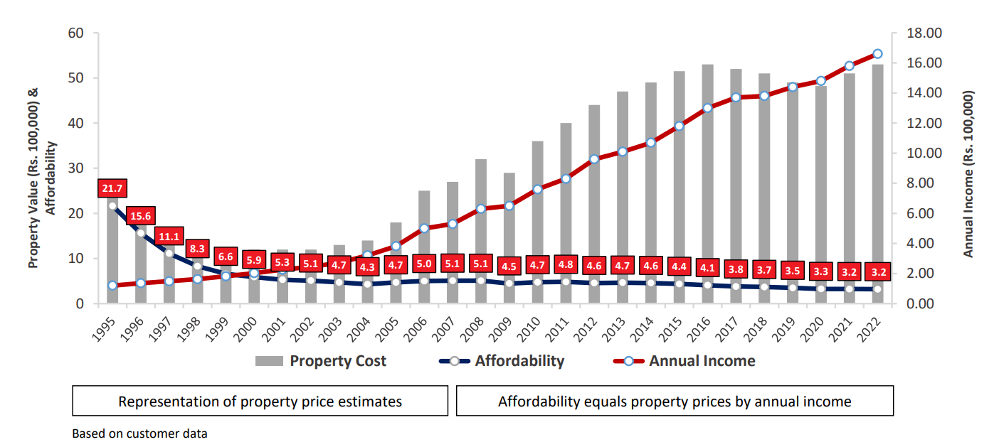
Housing Affordability continues to be the best in 2.5 decades
Rising incomes & Government support towards housing has helped improve affordability
Source: HDFC Limited investor presentation, based on their customer data

Slide 27
New Project marketing is a ~3000 cr market; digital spends growing faster
New Projects marketing (FY23)
Digital share of spends @42%
Google/FB biggest competitors
99acres share of Digital spends @ 14%
Large headroom to grow, specially during new launches
Note: Extrapolated basis FY23 till Dec & Q4FY23 estimates. Portals spend on google/Fb which is ~160-170cr excluded. Source: MCA filings, competitive interviews, mass media spend (TV, Print, Radio, OOH) tracker from agencies (Adex), secondary research
Notes:
Our launch penetration is also weak. Plans to improve it – know on time, activate on time, unified delivery unit to drive delivery on platform and outside platform, specially for top clients

Slide 28
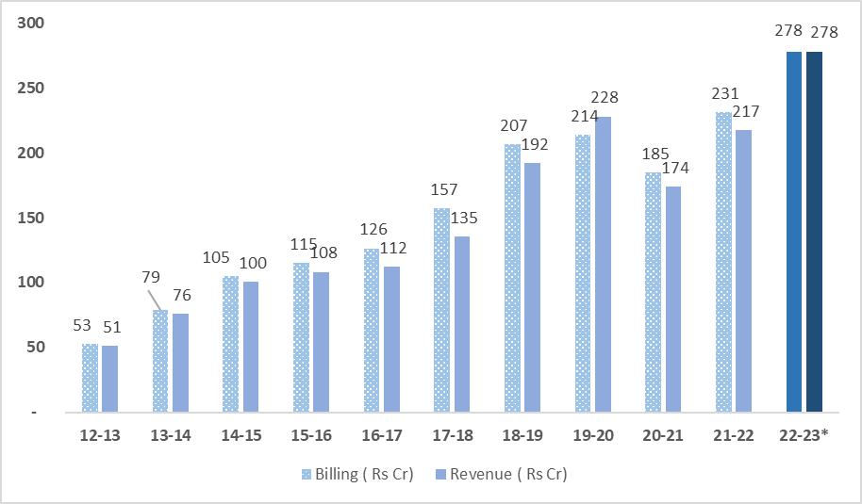
Financial Overview
Billing Growth :18% CAGR in last 10 years
Billing and Revenue for FY23 projected basis extrapolation of average billing and revenues for the first 9 months

Slide 29
Financial Investments

Slide 30











Financial Investments
Investments through IEIL Balance Sheet *
Investments through AIFs
Phase 1- 2007-2014
Info Edge Venture Fund **
Major Investments:
Phase 2- 2016-2020
Major Investments:
Info Edge Capital Fund & Capital 2B
** Around 30 Investments till date.
Market Value of investments in Listed Entities - Rs 9,650 Cr
Total Commitments ~USD 212.5MN
Total Funds Allocated till date Rs 875 Cr.
Total 23 Active investments till 31st Dec’22
Net ( Gross- Realization) investment of Rs 1361 Cr.

Slide 31
Investment Philosophy.
All investments are done/ to be done in Indian startup ecosystem with no sectoral preference.
The investee companies are either tech led or tech enabled and solve for a local problem.
Invest early at Seed/ Pre Series A or Series A stage and prefer to be the first institutional investor in the business.
Initial investments to be of small ticket size.
Investment holding period of 12-14 years.
Future rounds of investments to be backed by sound business performance and treatment of minority shareholders by founders.

